Slide 1
WifiLocator
Build the floor plan map of jessup hall
Build the coordinates according to the pixels of the map.
Construct the reference signature database: <signature List, Coordinate>
Define the distance Metric.
Calculate the centroid of reference signature.

Slide 2
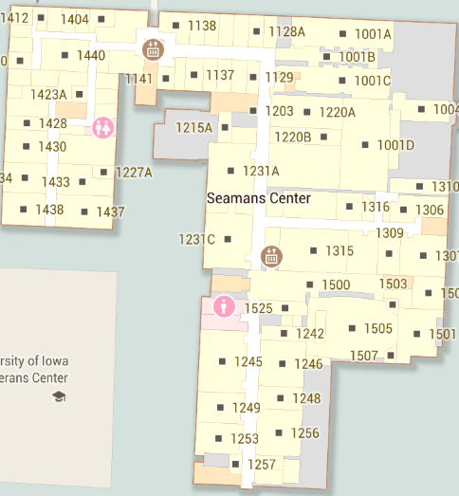
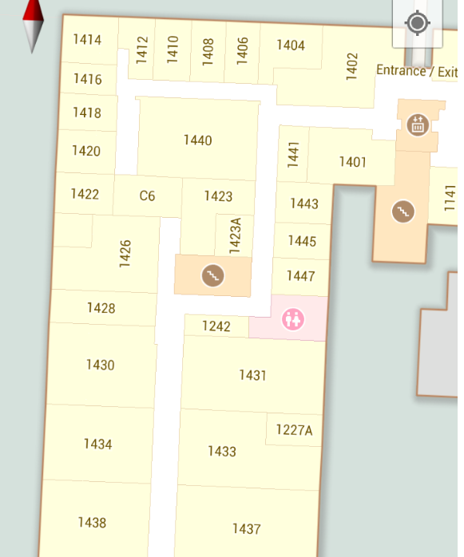
Build the map

Slide 3
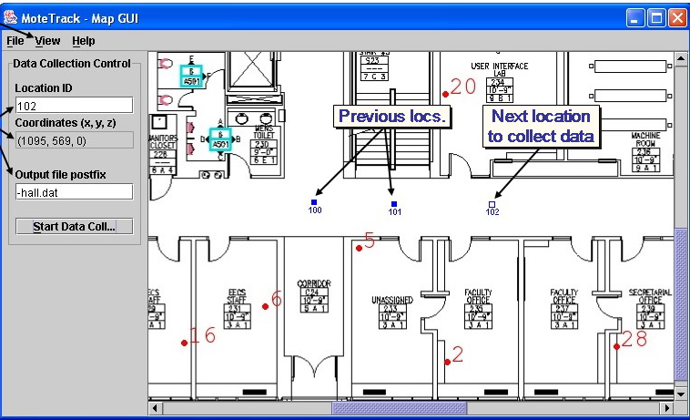
Get the coordinates By pixel

Slide 4
DistanceMetric and Location estimate
Manhantan Distance: Unidirectional distance metric.
Location estimate:
By weighting each reference signature’s location with the signature distance, we bias the location estimate towards ‘‘nearby’’ reference signatures.

Slide 5
Notes
What is the exact form of a reference signature? (coordinate, mac1, rssi1, mac2, rssi2……)
How can we get the floor plan of Jessup hall?
We need to build a Java Application to get the coordinates in a map by pixels. Who will do this?
GUI part is very important to our application. Who will take this part? (this may include: load the map, double buffering, location update… …)

